Slide 1
Web API Help Pages with Swagger

Slide 2
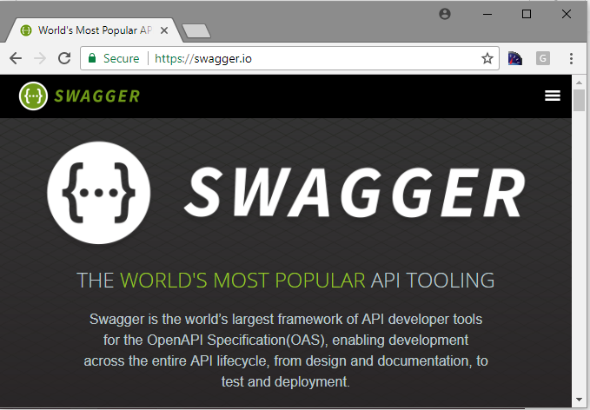
What is Swagger?
Swagger,(https://swagger.io) also known as Open API, solves the problem of generating useful documentation and help pages for Web APIs.
It provides benefits such as interactive documentation, client SDK generation, and API discoverability.

Slide 3
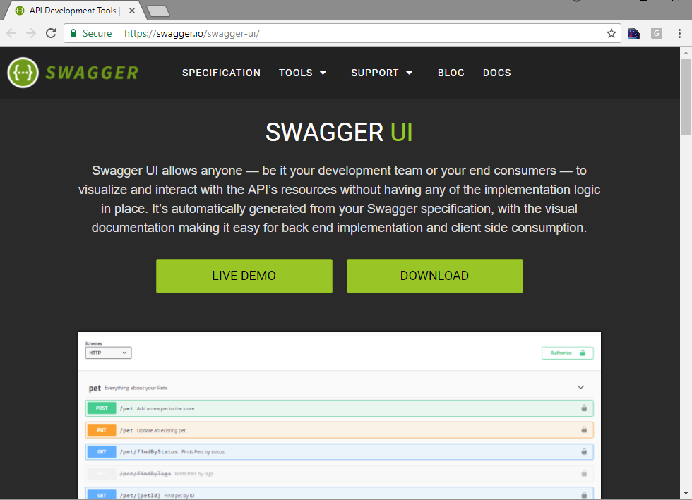
Swagger UI

Slide 4
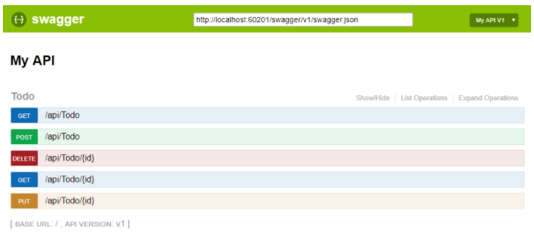
Swagger UI
Swagger UI offers a web-based UI that provides information about the service, using the generated Swagger specification.
Both Swashbuckle and NSwag include an embedded version of Swagger UI, so that it can be hosted in your ASP.NET Web API. The web UI looks like this:

Slide 5
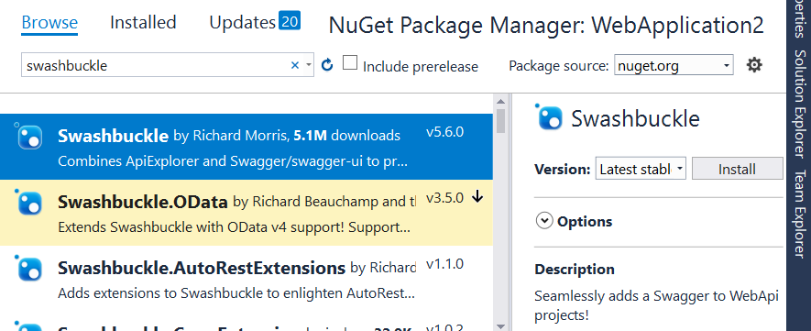
Using Swashbuckle
Add NuGet Package : swashbuckle
Browse to /swagger/ui/index

